Slide 1
QBot
Package Identification using Turtlebot

Slide 2
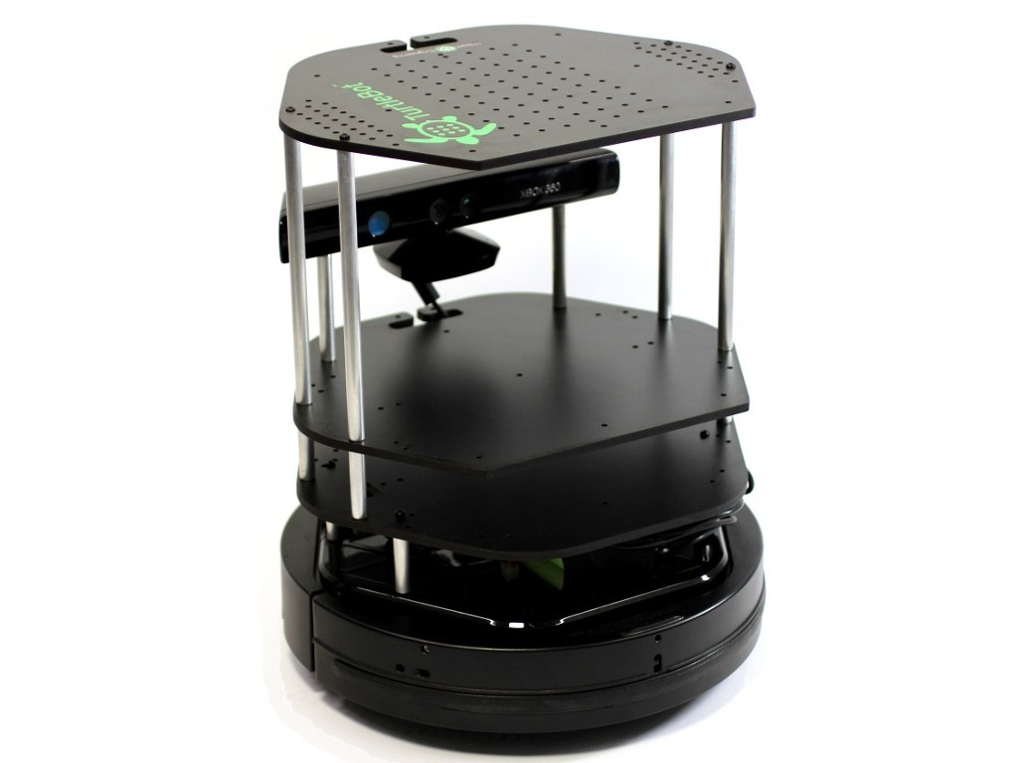
Project Idea
Problem:
Identifying newly arrived packages in a warehouse can be energy and time consuming for large number of packages. How can this be automated?
Warehouse management is already a big problem due to the
boom in e-commerce.
One possible solution:
Using low-cost robots (such as the Turtlebot) to perform the detection and identification for us.
Warehouse robots are already used for carrying packages and
shelves. Our solution is an augmentation to this already existing solution.

Slide 3
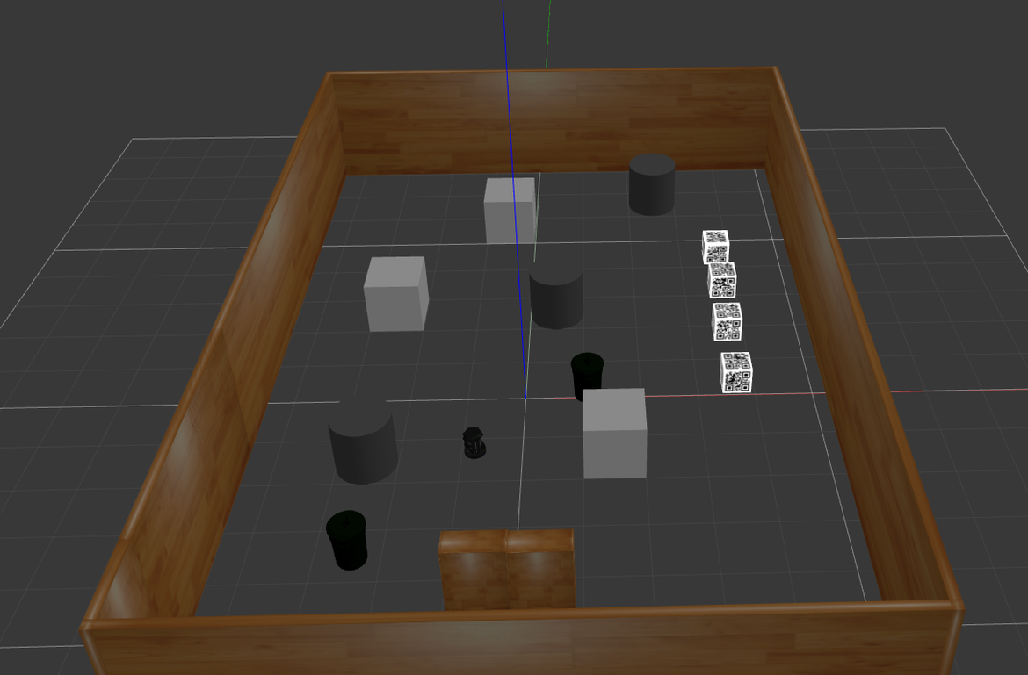
Our current implementation
Realistic simulation of Turtlebot in a warehouse setting in Gazebo. (turtlebot_gazebo package used.)
Turtlebot avoids obstacles (unmapped ones also) and navigates to the packages. (move_base)
The QR code on the package is detected and decoded to identify the package.
Assumptions:
Map of the environment is known.
The package locations are known, but IDs are unknown.
The QR code (Version 1) is on all sides of the packages and is visible brightly.

Slide 4
About us
Adarsh Jagan Sathyamoorthy
2nd year Robotics student at UMD.
Primary interests - Computer Vision, and Planning
Main Roles:
Creating the Gazebo environment, mapping, and navigation.
Driver for integration of QReader and PathPlanner.
Driver for Test functions of PathPlanner class
Navigator for test function in QReader class

Slide 5
About us (cont’d)
RajendraMayavan Rajendran Sathyam
2nd year Robotics student at UMD.
Primary interests - Computer Vision, and Industrial Automation
Main Roles:
Driver for implementing QR-code reader and decoder.
Navigator for integration of vision and navigation.
Setting up continuous integration
Driver for Test functions of QReader class
Navigator for test function in PathPlanner class

Slide 6
UML Diagrams
Class and Activity

Slide 7
Running the demo

Slide 8
Potential future work
Make QR code detection more robust to perspective changes.
Making the Turtlebot detect small QR codes of higher versions.
Use multiple coordinating robots to identify multiple packages simultaneously.

